Slide 1


Slide 2
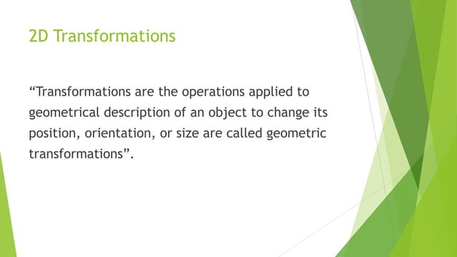

Slide 3
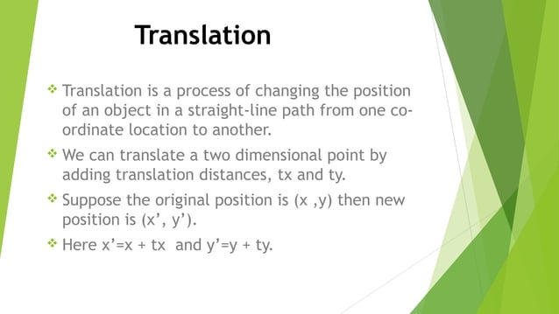

Slide 4
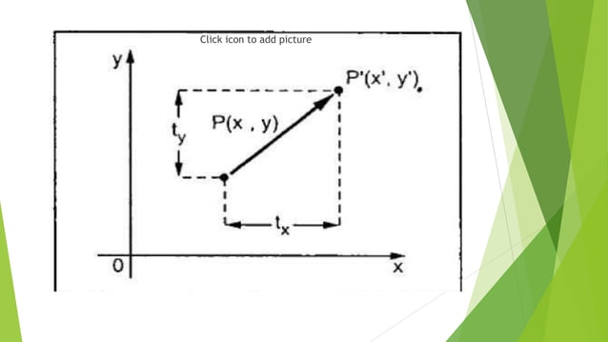

Slide 5
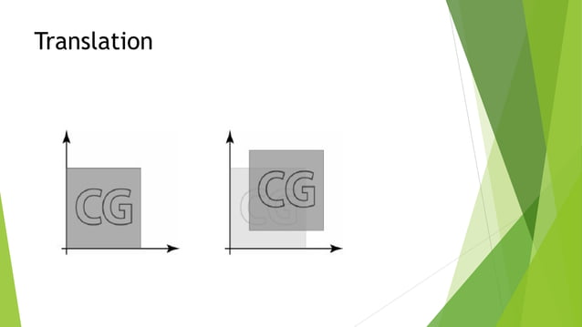

Slide 6
Translate the point (2,4) where T(-1,14) Find P’
Translate the polygon with A(2,7) B(7,10) C(10,2) by 3 units in X direction and 4 units in Y direction

Slide 7
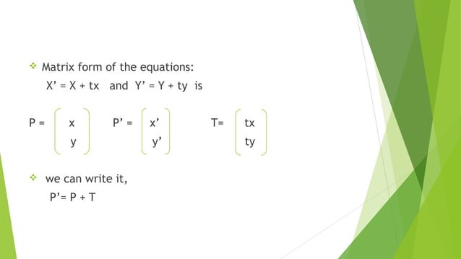

Slide 8
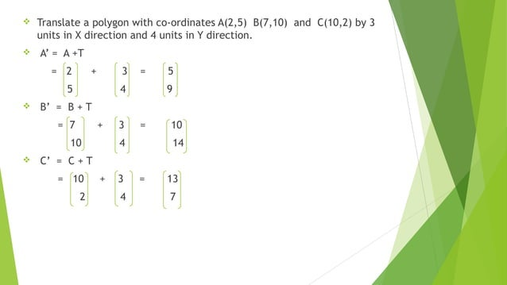

Slide 9
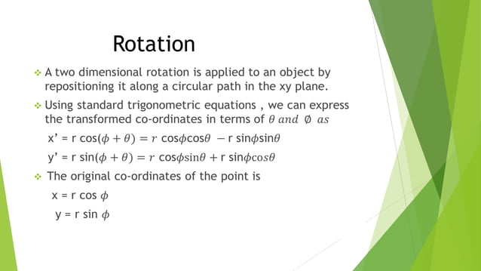

Slide 10
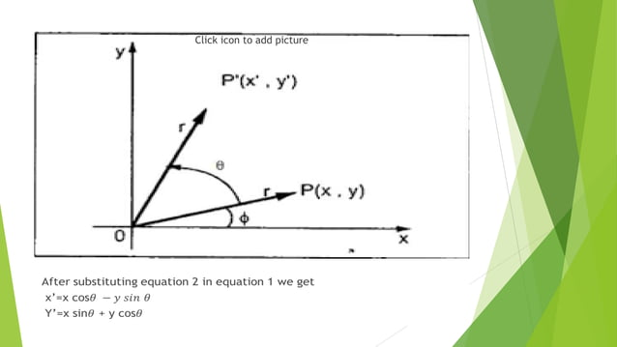

Slide 11
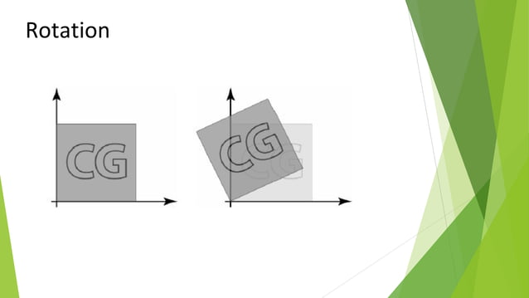

Slide 12
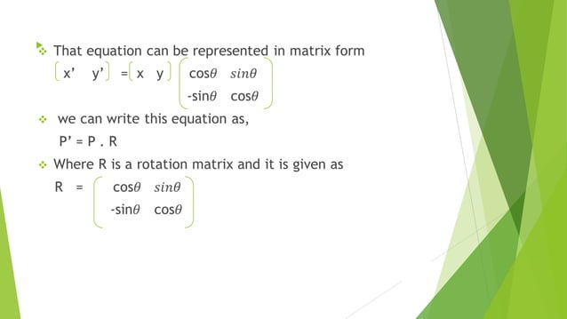

Slide 13
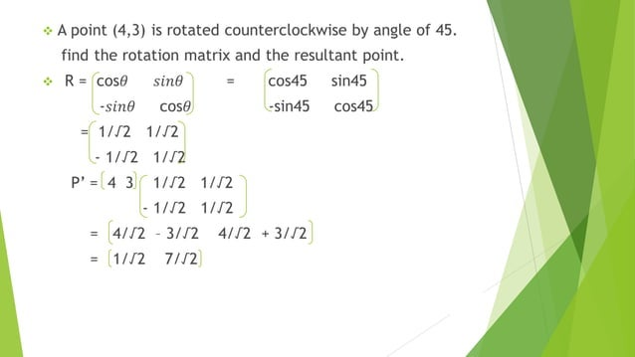

Slide 14
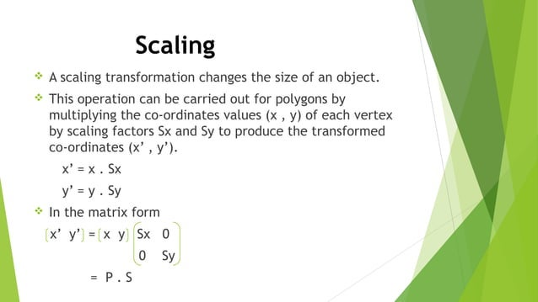

Slide 15
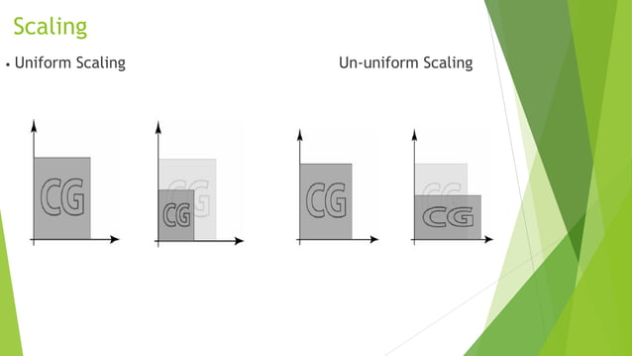

Slide 16
Ex. Scale a polygon with co-ordinates A(2,5), B(7,10) and C(10,2) by 2 units in X direction and 3 units in Y direction

Slide 17
Translate a square ABCD A(0,0),B(3,0), C(3,3) and D(0,3) by 2 units in both direction then scale it by 1:5 units in X-direction and 0.5 in Y direction. Determine the resultant co-ordinated of polygon

Slide 18
Answer
Translation:
A’(2,2) B’(5,2) C’(5,5) D’(2,5)
Scaling:
A’’(3,1) B’’(7.5,1) C”(7.5,2.5) D”(3,2.5)

Slide 19
Ex. Magnify the triangle with vertices (0,0),(1,1),(5,2) to twice its size while keeping (5,2) fixed
Scaling: A’(0,0) B’(2,2) C’(10,4)
Traslation: A”(-5,-2) B”(-3,0) C”(5,2)

Slide 20
Rotate a Triangle A(0,0) B(2,2) C(4,2) about the origin by an angle of 45°

Slide 21
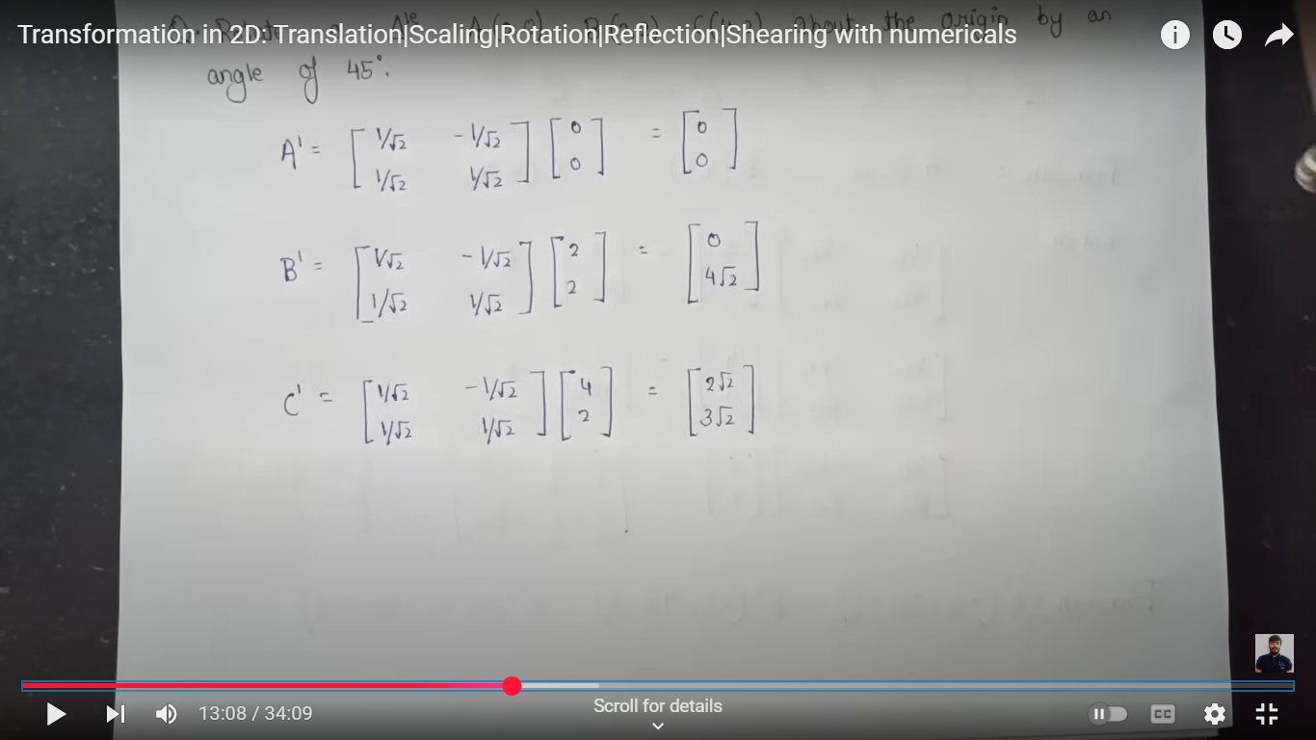

Slide 22
Homogeneous coordinates
To display three-dimensional objects on two-dimensional image planes.
Homogeneous coordinate provides a standard to perform certain standard operations on points in euclidean space means matrix multiplication.

Slide 23
Homogeneous coordinate systems are used in two ways in computer graphics. One of them is by taking an extra value (for example taking the third element in two dimensions and the fourth element in three dimensions) extra element can be any value that will be the divisor of other components which is used occasionally. The restricted form of homogeneous coordinate is also valuable in computer graphics it solves problems in representing and implementing transformations of geometric objects.
Now take an example for convert (3,4) into a homogeneous coordinate if h=2.
new coordinate=(3*2,4*2,h)
=(6,8,h)

Slide 24
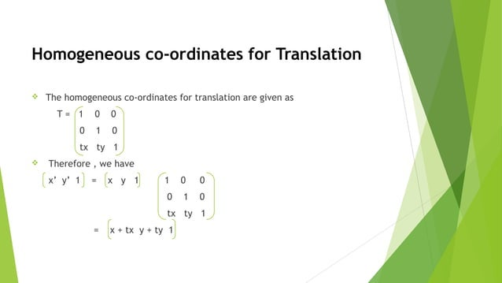

Slide 25
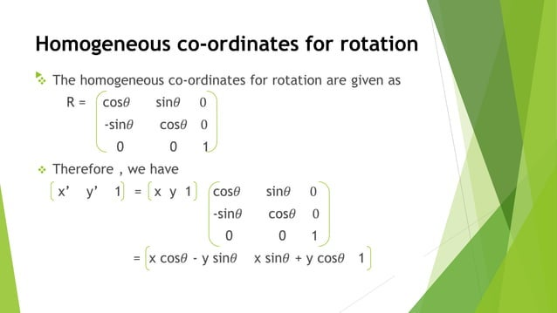

Slide 26


Translation:
It will shift the object from one position to another position, with the given translation in the x or y axis to translate a point from coordinate position (x,y) to another (x,y) we add algebraically the translation distances tx and ty to the original coordinates
Example: a(2,2), b(10,2), c(5,5) translate the triangle with dx=5 dy=6.
a’=a+ t
b’=b +t
c’=c +t

Slide 27
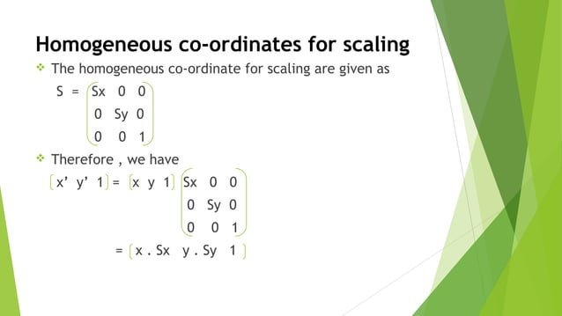

Slide 28
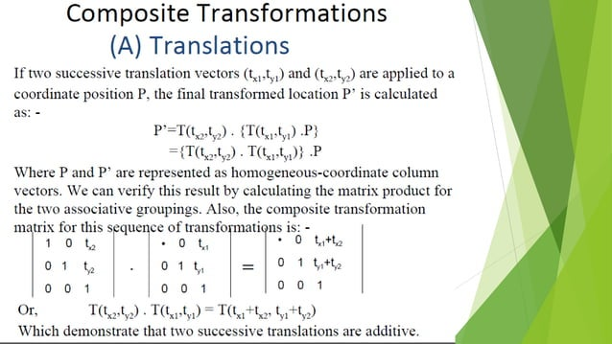

Slide 29
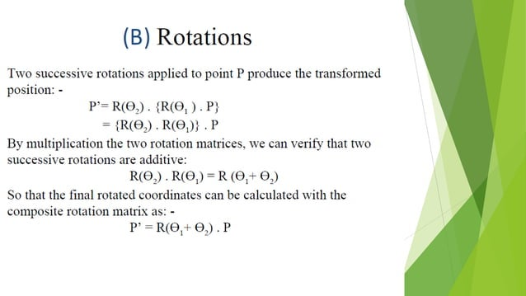

Slide 30
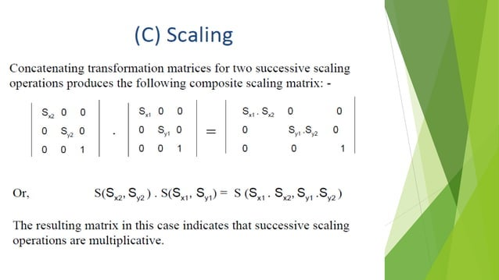

Slide 31
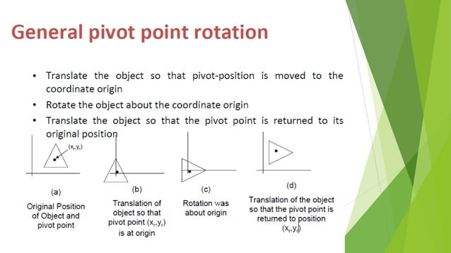

Slide 32
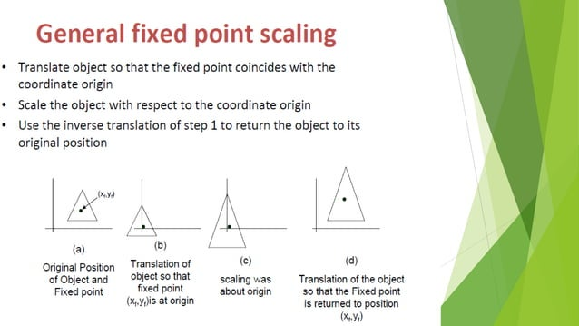

Slide 33
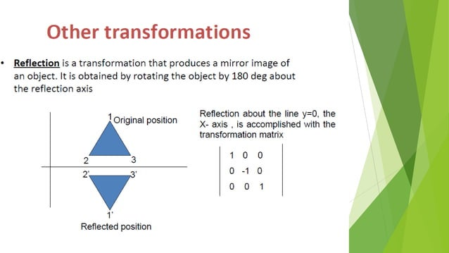

Slide 34
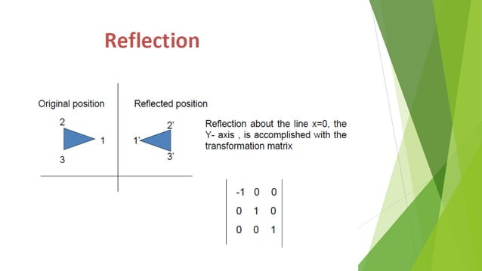

Slide 35
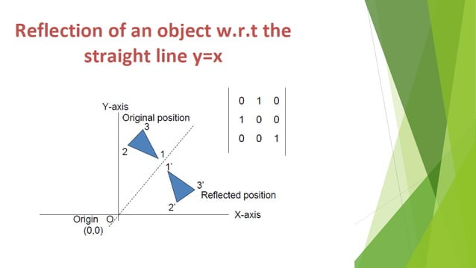

Slide 36
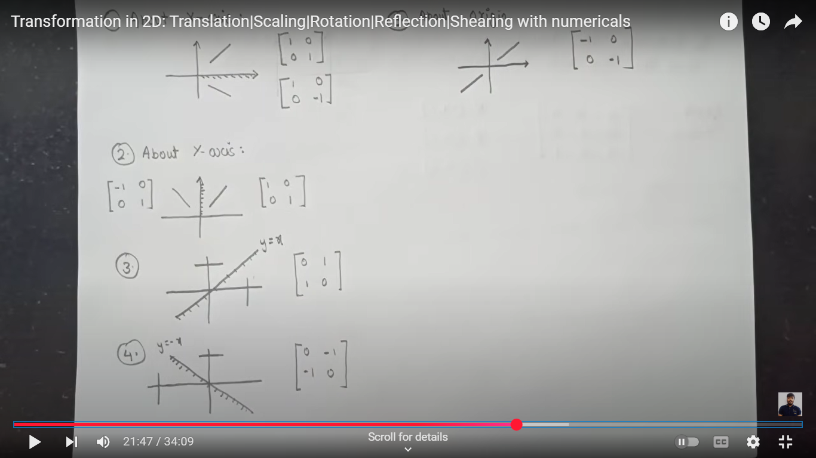

Slide 37
Determine the transformation matrix of a triangle A(4,1) B(5,2) C(4,3) about the line x=0 and determine the resultant co-ordinates.

Slide 38
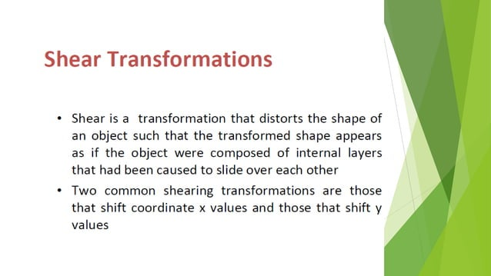

Slide 39
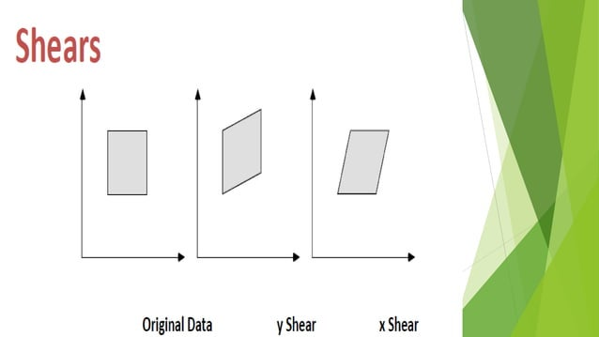

Slide 40
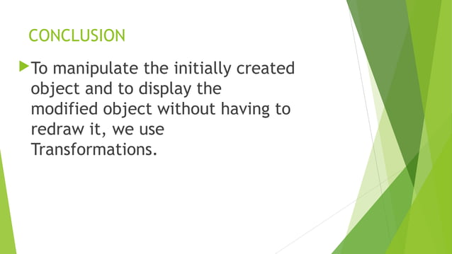

Slide 41


